Slide 1
Mutiple access/Media Access protocols

Slide 2
There are two types of network links: point-to-point links and broadcast links.
A point-to-point link consists of a single sender at one end of the link and a single receiver at the other end of the link.
Eg: link-layer protocols for point-to-point links; the point-to- point protocol (PPP)
A broadcast link, can have multiple sending and receiving nodes all connected to the same, single, shared broadcast channel, The term broadcast is used because when any one node transmits a frame, the channel broadcasts the frame and each of the other nodes receives a copy. Eg: Ethernet and wireless LANs

Slide 3
Computer networks have protocols - so-called multiple access protocols - by which nodes regulate their transmission into the shared broadcast channel.
Multiple access protocols are required in a wide variety of network settings, including both wired and wireless local area networks, and satellite networks.
Because all nodes are capable of transmitting frames, more than two nodes can transmit frames at the same time. When this happens, all of the nodes receive multiple frames at the same time; that is, the transmitted frames collide at all of the receivers.
Normally, when there is a collision, none of the receiving nodes can make any sense of any of the frames that were transmitted.

Slide 4
In this way, all the frames involved in the collision are lost, and the broadcast channel is wasted during the collision interval. Clearly, if many nodes want to transmit frames frequently, many transmissions will result in collisions, and much of the bandwidth of the broadcast channel will be wasted.
In order to ensure that the broadcast channel performs useful work when multiple nodes are active, it is necessary to somehow coordinate the transmissions of the active nodes. This coordination job is the responsibility of the multiple access protocol.

Slide 5
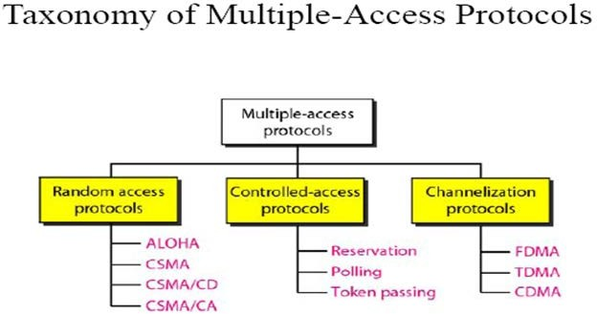

Slide 6
Random Access Protocols(Contention)
In random access or contention methods, no station is
superior to
another station and none is assigned the control over another.
At each instance, a station that has data to send uses a procedure defined by the protocol to make a decision on whether or not to send.(depends on the state of the medium)
There is no scheduled time for a station to transmit. Transmission is random among the stations (random access)
Second, no rules specify which station should send next. Stations compete with one another to access the medium. That is why these methods are also called contention methods.
In a random access method, each station has the right to the medium without being controlled by any other station. However, if more than one station tries to send, there is an access conflict—collision—and the frames will be either destroyed or modified

Slide 7
Random Access Protocols
Random access methods have evolved from a protocol called ALOHA which uses a simple procedure called Multiple Access(MA)
This method was improved with the addition of a procedure that forces a station to sense the medium before transmitting. This is called CSMA.
This method later evolved into two other methods CSMA/CA and CSMA/CD

Slide 8
ALOHA
Developed at the University of Hawaii for packet radio networks, applicable to any shared medium
Pure ALOHA-original ALOHA protocol
Station can transmit frame at any time
Then listens for an amount of time equal to the maximum possible round trip propagation delay
If an ACK come during that time, OK, else resends the frame
If a station fails to receive ACK after repeated transmissions, it gives up
If two stations transmits at a time, collision
If the received frame is invalid, simply ignores

Slide 9
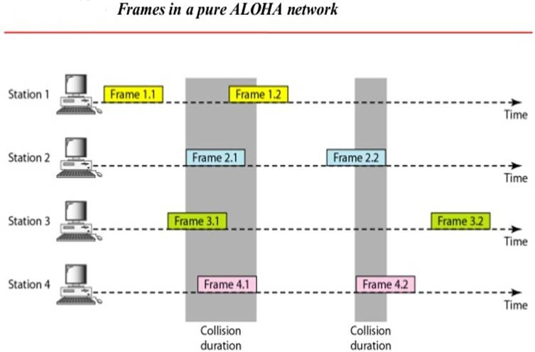

Slide 10
We need to resend the frames that has been destroyed during transmission .
The pure ALOHA relies on acknowledgements from the receiver.
After sending a frame the sender waits for acknowledgement and if it does not receive ,then after timeout period it resends the frame.
A collision involves two or more stations .If all these stations tries to resend their frames after the time out the frames will collide again.
Pure ALOHA dictates that when the time out period passes each station waits for random amount of time before resending the frame. The randomness avoids further collisions.

Slide 11
Slotted ALOHA
In Pure ALOHA there is no rule that defines when a station can send. A station may send soon after another station has started or soon after another station has finished.
Slotted ALOHA was invented to improve the efficiency of pure ALOHA.
In slotted ALOHA we divide the time into slots and force the station to send only at the beginning of the time slot.

Slide 12
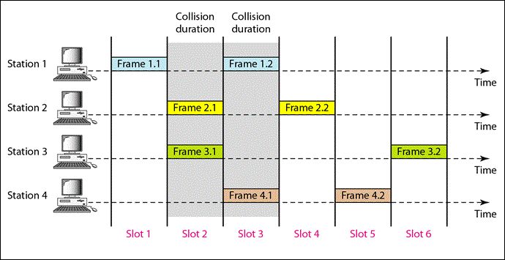

Slide 13
Because a station is allowed to send only at the beginning of a time slot , if a station misses this moment it should wait until the beginning of the next slot
But there is still a possibility of collision ,if two stations tries to send at the beginning of the same time slot.

Slide 14
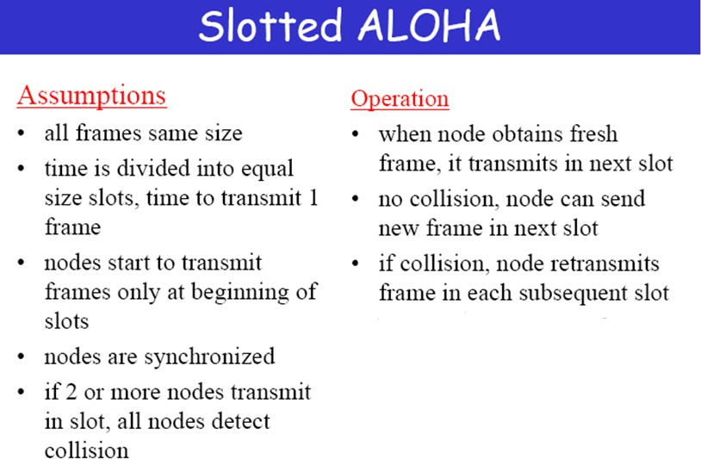

Slide 15
Slotted ALOHA
Time on the channel is organized into uniform slots
Size of slots is equal to the frame transmission time
Central clock is used for synchronize stations
Transmission is permitted to begin only at time slot boundary
Frames overlaps either totally or not.
Utilization increases to 37% than 18% of Pure ALOHA
Poor utilization of channel capacity in ALOHA methods.

Slide 16
Carrier Sense Multiple Access
A station wishing to transmit first listens the medium to determine another transmission is in progress.
This process is called carrier sense.
If the medium is in use, station will wait else station may transmit.
If more than one station attempt to transmit at about the same time, Collision.
After transmitting data, source station waits reasonable amount of time.
Waiting time will be maximum round-trip propagation delay + time required by destination station to get medium
If there is no Ack, collision hence retransmission
Maximum utilization can be much better than ALOHA

Slide 17
What happens if station finds the medium is busy
Non persistent CSMA:
A station wishing to transmit listens to the medium and obeys the following rules
If the medium is idle, transmit else go to step 2
If the medium is busy , wait an amount of time and repeat step 1
(2) 1-Persistant CSMA:
A station wishing to transmit listens to the medium and obeys the following rules
If the medium is idle ,transmit else go to step 2
If the medium is busy , continue to listen until the channel is sensed idle, then transmit immediately

Slide 18
(3) P-persistent
This method is used when channel has time slots such that the time slot duration is equal to or greater than the maximum propagation delay time.
Whenever a station becomes ready to send, it senses the channel.
If channel is busy, station waits until next slot.
If channel is idle, it transmits with a probability p.
With the probability q=l-p, the station then waits for the beginning of the next time slot.
If the next slot is also idle, it either transmits or waits again with probabilities p and q.
This process is repeated till either frame has been transmitted or another station has begun transmitting. In case of the transmission by another station, the station acts as though a collision has occurred and it waits a random amount of time and starts again.

Slide 19
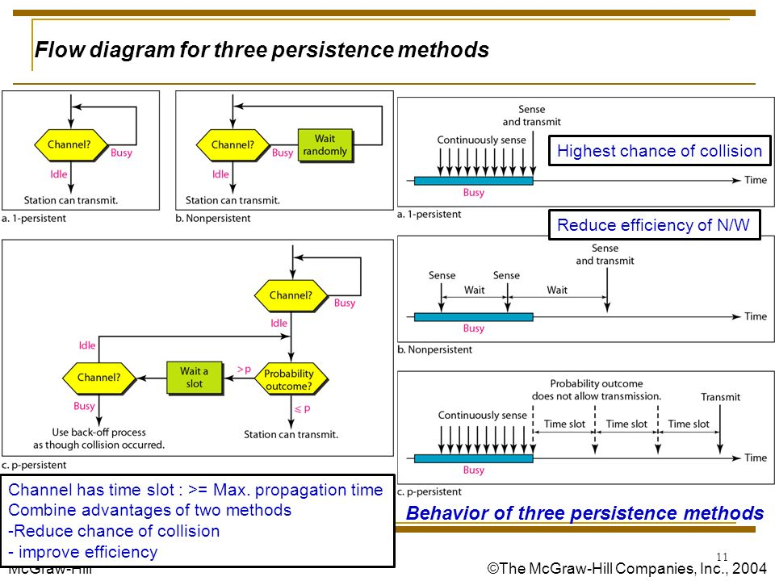

Slide 20
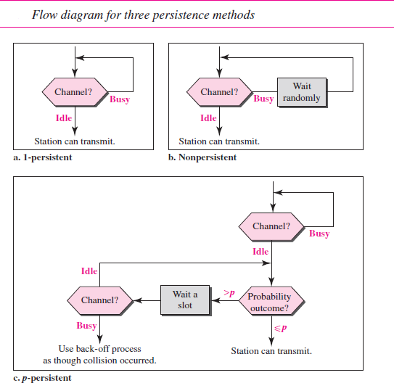

Slide 21
CSMA/CD
When two frames collide, the medium remains unstable for the duration of transmission of both damaged frames
Hence an alternate method, where
A station continues to listen to the medium while transmitting
Rules of CSMA/CD
If the medium is idle, transmit
If the medium is busy, continue to listen until the channel is idle; then transmit immediately
If a collision is detected during transmission, transmit a brief jamming signal to assure that all stations know that there is a collision and then cease transmission
After transmitting jamming signal, wait a random amount of time, referred to as backoff then attempt to transmit again

Slide 22
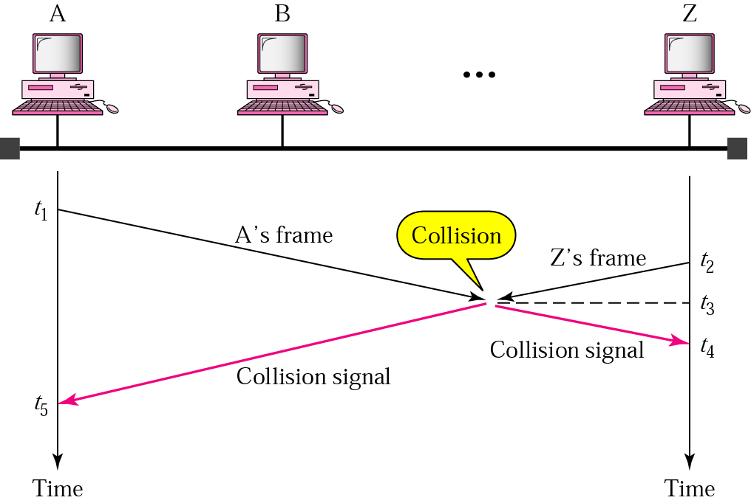

Slide 23

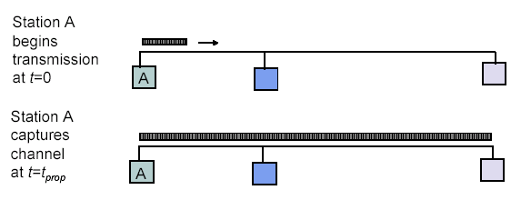
Maximum Propagation Delay
Maximum propagation delay(t_{prop}): time it takes for a bit of a frame to travel between the two most widely separated stations.
The farthest station
Station B receives the first bit of the frame at time t= t_{prop}

Slide 24
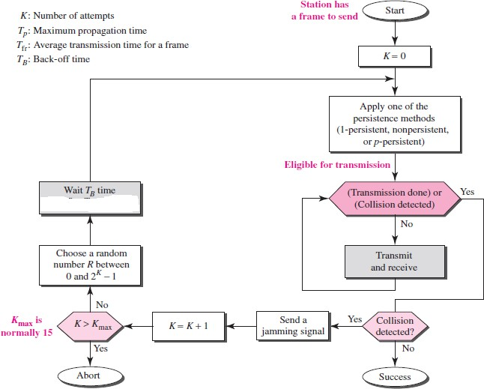

Slide 25
Exponential Backoff
Backoff is the process by which a transmitting station determines how long to wait following a collision before attempting to retransmit the frame.
If all stations waited the same length of time before retransmission, then another collision would inevitably occur.
This is avoided by having each station generate a random number which determines the length of time it must wait before testing the carrier. This time period is known as the station's "backoff delay".

Slide 26
CSMA/CA
CSMA/CD is detecting collisions while transmitting data
Collisions can be detected with the help of energy of the signal
In wired network, energy of the signal is almost double when collision occurs, hence easy detection
But in wireless communication, energy level may not increase to a considerable level when collision occurs, hence less chance to detect collisions
Collision avoidance is better method than collision detection in these type of networks

Slide 27
Collisions are avoided through the use of CSMA/CA’s three strategies: the interframe space, the contention window, and acknowledgments.
Interframe Space (IFS)
First, collisions are avoided by deferring transmission even if the channel is found idle. When an idle channel is found, the station does not send immediately. It waits for a period of time called the interframe space or IFS.
Even though the channel may appear idle when it is sensed, a distant station may have already started transmitting.

Slide 28
ContentionWindow
The contention window is an amount of time divided into slots. A station that is ready to send chooses a random number of slots as its wait time.
It is set to one slot the first time and then doubles each time the station cannot detect an idle channel after the IFS time.
However, if the station finds the channel busy, it does not restart the process; it just stops the timer and restarts it
when the channel is sensed as idle. This gives priority to the station with the longest waiting time.
Acknowledgeent
The positive acknowledgment guarantee that the receiver has received the frame.

Slide 29
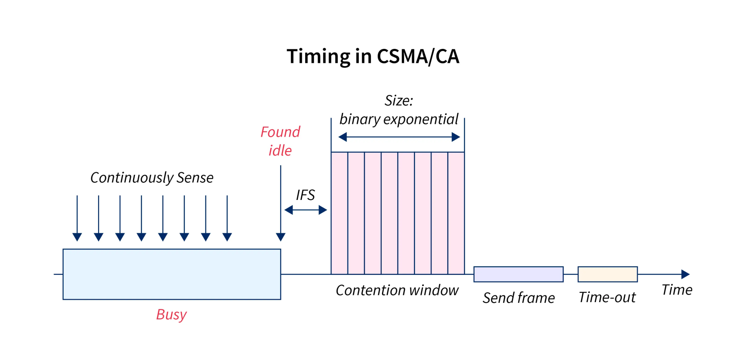

Slide 30
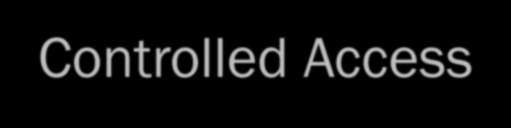
Controlled Access
Stations consult one another to find which station has the right to send
A station cannot send unless it has been authorized by other stations
Three controlled access methods
Reservation
Polling
Token Passing

Slide 31
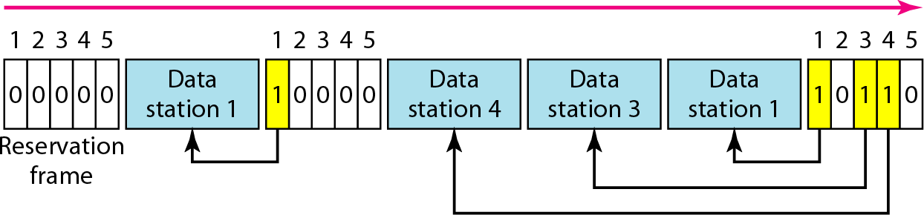
1-Reservation access method
Stations take turns transmitting a single frame at a full rate ( R ) bps
Transmissions are organized into variable length cycles
Each cycle begins with a reservation interval that consists of (N) minislots. One minislot for each of the N stations
When a station needs to send a data frame, it makes a reservation in its own minislot.
By listening to the reservation interval, every station knows which stations will transfer frames, and in which order.
The stations that made reservations can send their data frames after the reservation frame.

Slide 32
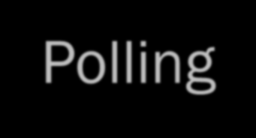
Polling
It works with topologies in which one device is primary station and all other stations are secondary stations
All data exchanges must be made through primary station, even when ultimate destinations are secondary
Primary device controls the link, secondary device follows its instruction
Primary station determines which station can use the channel

Slide 33
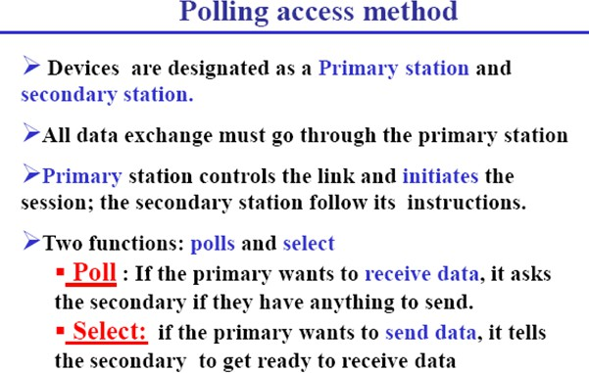

Slide 34
Polling
When primary want send or receive data, it uses Select function or Poll function
Select
This function is used when primary device want to send data
If the primary is neither sending nor receiving data, medium is available. Since all data transmissions happens through primary
Primary alerts desired secondary by sending select(SEL) frame
It waits for acknowledgment before sending data

Slide 35
Polling
Poll
It is the process in which the primary stations asks secondary station, whether they want to send data
Primary Polls all secondary stations in turn
If the secondary want to send data, it responds with data frame
Otherwise responds with NAK frame
When data is received from secondary, it responds with ACK frame

Slide 36
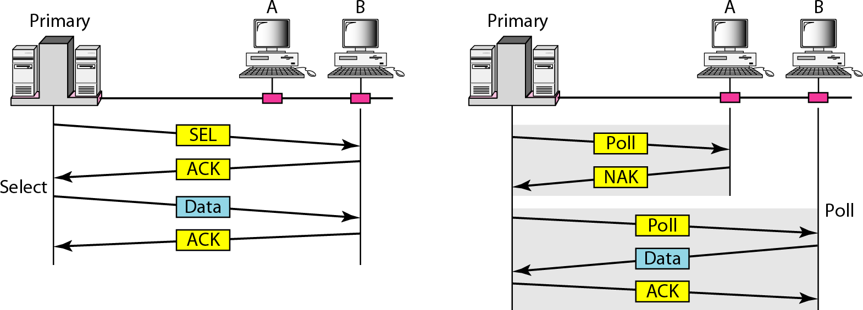
SELECT and POLL functions

Slide 37
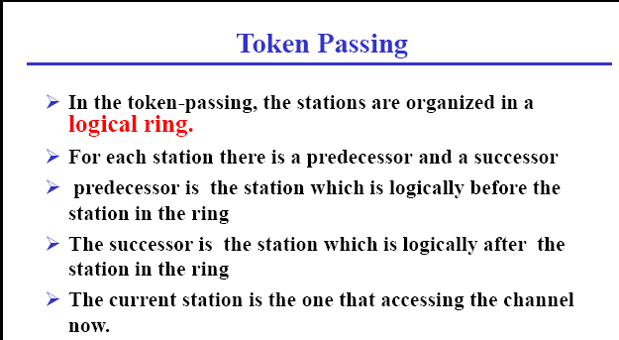

Slide 38
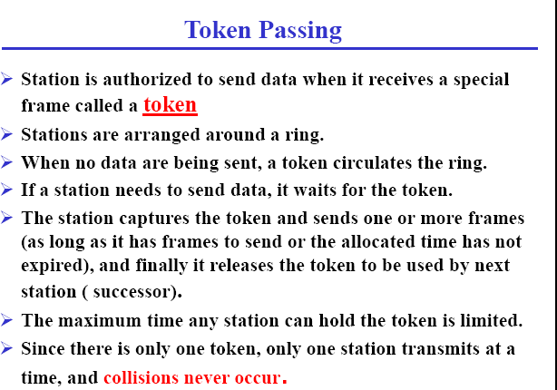

Slide 39
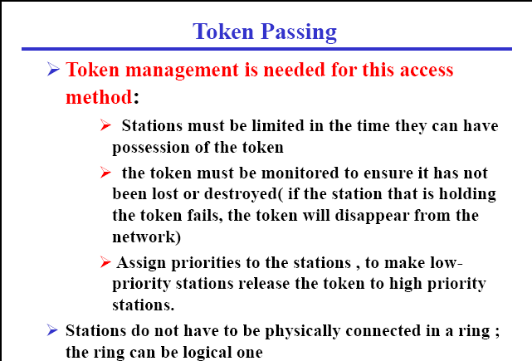

Slide 40



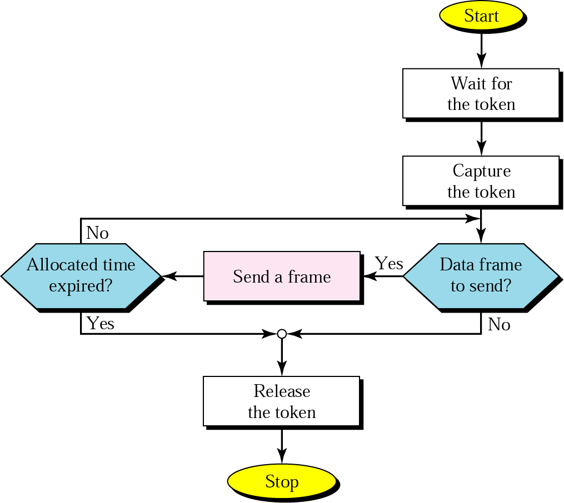
Token-passing procedure

Slide 41
CHANNELIZATION PROTOCOLS
Channelization (or channel partition) is a multiple-access method in which the available bandwidth of a link is shared in time, frequency, or through code, between different stations.
Frequency-Division Multiple Access (FDMA)
The available bandwidth is divided into frequency bands. Each station is allocated a band to send its data.
Each band is reserved for a specific station, and it belongs to the station all the time.
Each station also uses a band-pass filter to confine the transmitter frequencies.

Slide 42
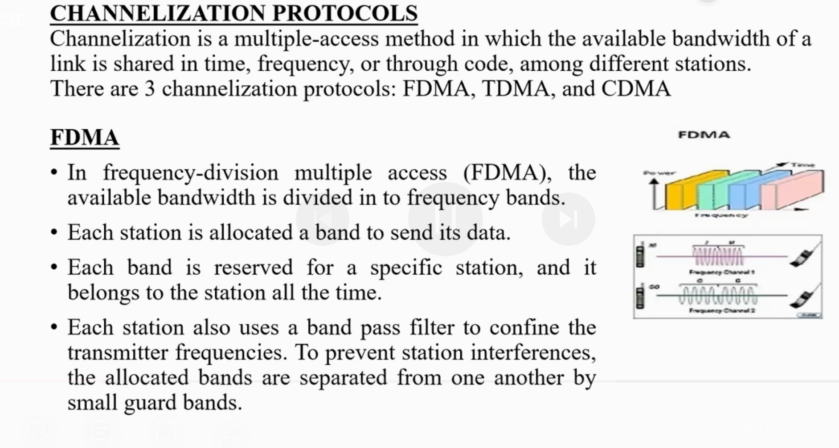

Slide 43
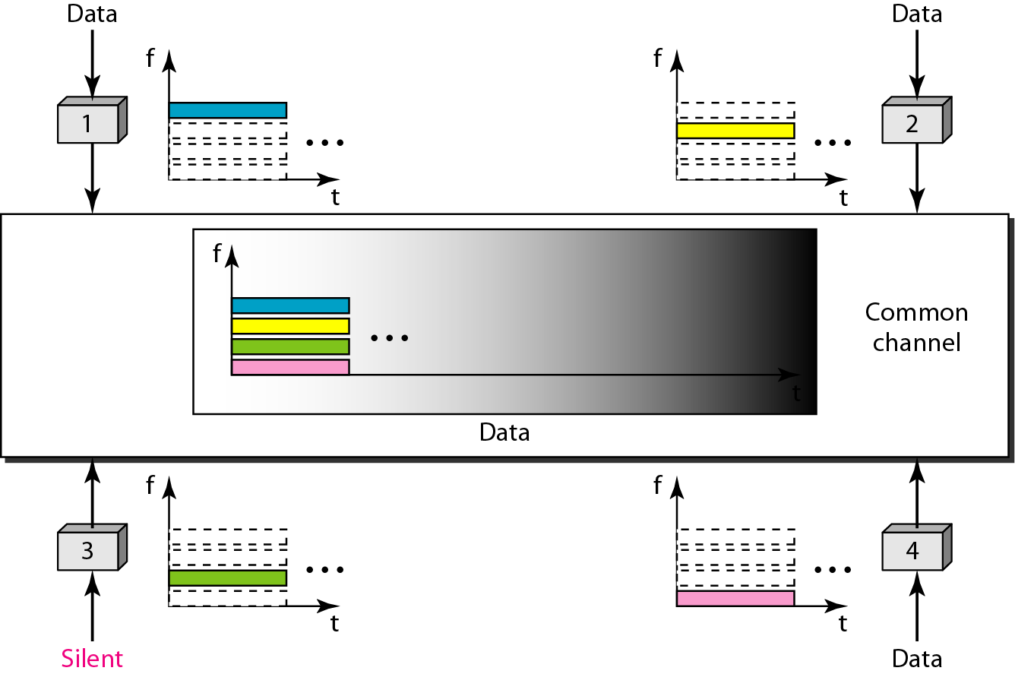
Figure 12.21 Frequency-division multiple access (FDMA)

Slide 44
FDMA specifies a predetermined frequency band for the entire period of communication.
This means that stream data (a continuous flow of data that may not be packetized) can easily be used with FDMA.
This feature can be used in cellular telephone systems
2. Time-Division Multiple Access (TDMA)
The stations share the bandwidth of the channel in time.
Each station is allocated a time slot during which it can send data.
Each station transmits its data in its assigned time slot.

Slide 45
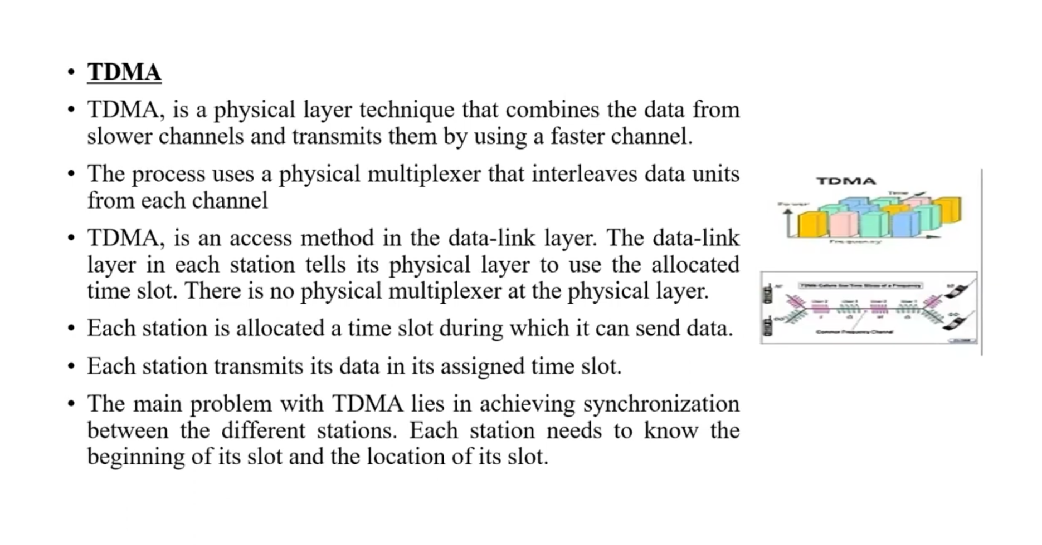

Slide 46
The main problem with TDMA lies in achieving synchronization between the different stations.
Each station needs to know the beginning of its slot and the location of its slot. This may be difficult because of propagation delays introduced in the system if the stations are spread over a large area.
To compensate for the delays, we can insert guard times. Synchronization is normally accomplished by having some synchronization bits (normally referred to as preamble bits) at the beginning of each slot.

Slide 47
12-3 CHANNELIZATION - TDMA
TDMA: Time Division Multiple Access
The entire bandwidth capacity is a single channel with its capacity shared in time between M stations
A node must always wait for its turn until its slot time arrives even when it is the only node with frames to send
A node is limited to an average rate equal R/M (where M is number of nodes) even when it is the only node with frame to be sent

Slide 48
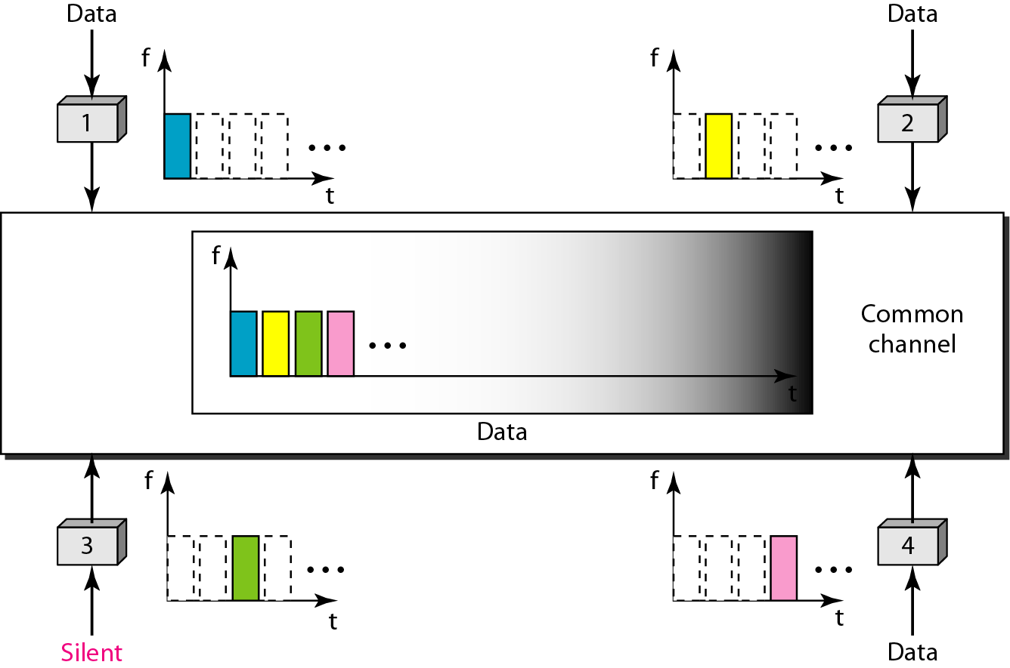
Figure 12.22 Time-division multiple access (TDMA)

Slide 49
12-3 CHANNELIZATION - CDMA
CDMA: Code Division Multiple Access
In CDMA, one channel carries all transmissions simultaneously
Each station codes its data signal by a specific codes before transmission
The stations receivers use these codes to recover the data for the desired station

Slide 50
Let us assume we have four stations, 1, 2, 3, and 4, connected to the same channel. The data from station 1 are d1, those from station 2 are d2, and so on.
The code assigned to the first station is c1, to the second is c2, and so on.
The assigned codes have two properties.
If we multiply each code by another, we get 0.
If we multiply each code by itself, we get 4 (the number of stations).
Station 1 multiplies (a special kind of multiplication) its data by its code to get d1 ⋅ c1.
Station 2 multiplies its data by its code to get d2 ⋅ c2, and so on.

Slide 51
Code-Division Multiple Access (CDMA)
CDMA differs from FDMA because only one channel occupies the entire bandwidth of the link.
It differs from TDMA because all stations can send data simultaneously; there is no time-sharing
CDMA simply means communication with different codes.
For example, in a large room with many people, two people can talk in English if nobody else understands English. Another two people can talk in Chinese if they are the only ones who understand Chinese, and so on.
In other words, the common channel, the space of the room in this case, can easily allow communication between several couples, but in different languages (codes).

Slide 52
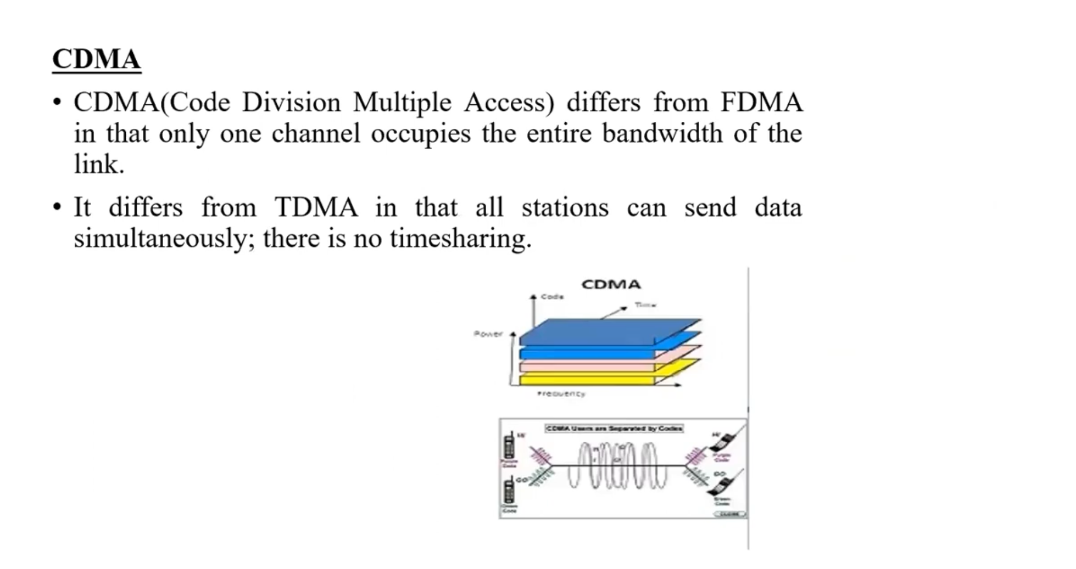

Slide 53
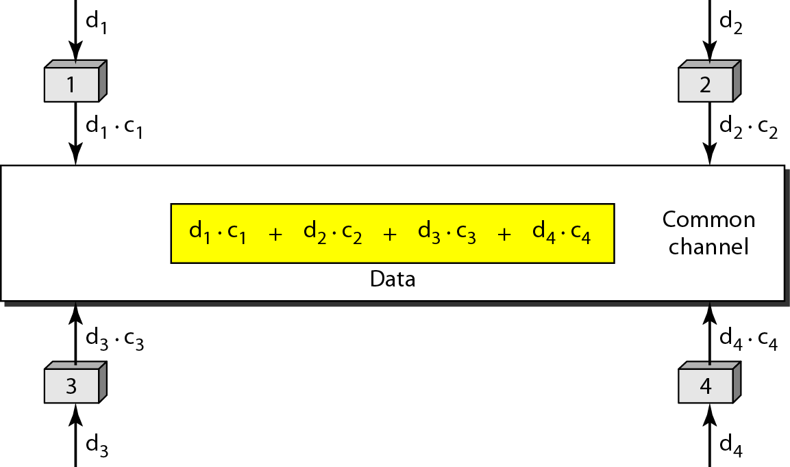
Figure 12.23 Simple idea of communication with code

Slide 54
The data that go on the channel are the sum of all these terms.
Any station that wants to receive data from one of the other three stations multiplies the data on the channel by the code of the sender.
For example, suppose stations 1 and 2 are talking to each other. Station 2 wants to hear what station 1 is saying. It multiplies the data on the channel by c1, the code of station 1.
Because (c1 ⋅ c1) is 4, but (c2 ⋅ c1), (c3 ⋅ c1), and (c4 ⋅ c1) are all 0s, station 2 divides the result by 4 to get the data from station 1.
data = [(d1 ⋅ c1 + d2 ⋅ c2 + d3 ⋅ c3 + d4 ⋅ c4) ⋅ c1] / 4 = [d1 ⋅ c1 ⋅ c1 + d2 ⋅ c2 ⋅ c1 + d3 ⋅ c3 ⋅ c1 + d4 ⋅ c4 ⋅ c1] / 4 = (4 × d1) / 4 = d1

